Slide 1


Slide 2
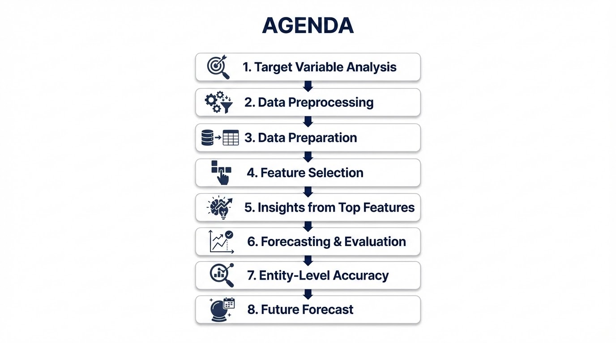

Slide 3
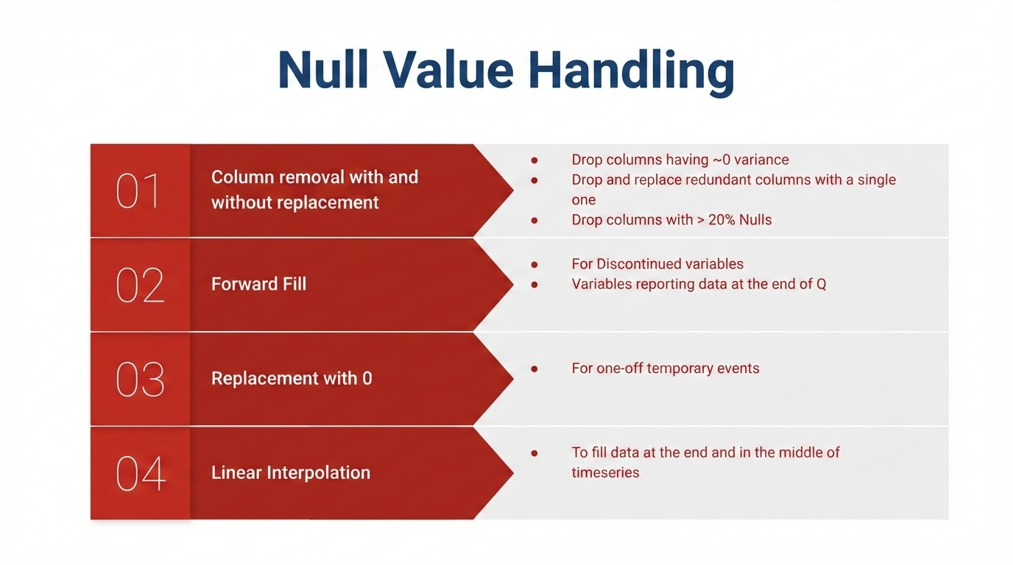

Slide 4
Data Preparation
Feature Selection
Separating segment-wise data
Splitting the data into train-test (70-30) sequentially.
Creating Lag feature of all variables
Dropping features/variables with high correlation, depicting multicolinearity.
Using Tree based approach for further selecting top features. A Gradient Boosting is effective in this case due to:
Handles Nulls effectively
Learns non-linear relations
Inbuilt regularization parameters to select features

Slide 5


